Slide 1

DAYANANDA SAGAR UNIVERSITY
SCHOOL OF ENGINEERING
Department of Computer Science and Engineering
Special Topic-2 Review 2
PERSONALITY CLASSIFICATION
Under the Supervision
Dr. Bondu Venkateswarlu
Associate Professor in CS
Presented By:
Amogh M Cheluvaraj (ENG20CS0026)
Arun V (ENG20CS0040)
Ankitha Shree B (ENG20CS0034)
C Bharat Reddy (ENG20CS0066)
Notes:
Title of the project
CSE Dept., SET-Jain University

Slide 2
Overview
Abstract
Problem Statement
Introduction
Social/Environmental Impact (If applicable)
State of the Art work (Literature survey)
Design
Methodology
References
Research Component/ Funding/Paper Publication Details(If any)
Dept of CSE., SOE-Dayananda Sagar University
<number> of 12

Slide 3
Abstract
Our focus for this project is using machine learning to build a classifier capable of sorting people into their Myers-Briggs Type Index (MBTI) personality type based on text samples from their social media posts and real-time dataset. The motivations for building such a classifier are:-
First, the pervasiveness of social media means that such a classifier would have ample data on which to run personality assessments, allowing more people to gain access to their MBTI personality type, and perhaps far more reliably and more quickly.
Our second motivation centers on the potential for our classifier to be more accurate than currently available tests as evinced by the fact that retest error rates for personality tests administered by trained psychologists currently hover around 0.5. That is, there is a probability of about half that taking the test twice in two different contexts will yield different classifications.
Thus, our classifier could serve as a verification system for these initial tests as a means of allowing people to have more confidence in their results. Indeed, a text-based classifier would be able to operate on a far larger amount of data than that given in a single personality test.
Dept of CSE., SOE-Dayananda Sagar University
<number> of 12

Slide 4
Problem Statement
Predicting personality by analyzing the behavior of the person is an old technique.
Analyzing personality based on one’s nature was a tedious task, and a lot of human effort would be required to do such analysis.
Precise definition of the problem
There is significant interest in this area within the academic realm of psychology as well as the private sector. For example, many employers wish to know more about the personality of potential hires, to better manage the culture of their firm.
Dept of CSE., SOE-Dayananda Sagar University
<number> of 12

Slide 5
Introduction
Most people believe that there are only two types of personalities: introverts and extroverts. MBTI evaluation helps us understand that personality is much more than that. With over 3.5 million assessments conducted each year, MBTI is the most widely used personality indicator globally.
The Myers Briggs Type Indicator (MBTI) is a personality type system that divides everyone into 16 distinct personalities based on 4 dimensions. Researchers widely use machine learning to predict personality and psychological traits from digital records.
But as a field of research, personality prediction is at a relatively early stage. It is important to understand if the predicted personalities retain characteristics from psychological science and understand performance expectations for real-world tasks.
We're developing an MBTI personality classifier that uses machine learning models to predict a person’s personality based on the social media posts and real-time data as input.
We find correlations between a person’s MBTI personality type and writing style. The classifier also demonstrates the validity of the MBTI test. We have used a decent amount of mined personality annotated data from social media.
Dept of CSE., SOE-Dayananda Sagar University
<number> of 12

Slide 6
Problem Objectives
Develop a Personality Classification Model which could be used for psychological science and understand performance expectations for real-world tasks.
Determining the user personality with Maximum Accuracy.
Determining the Personality of a Person in least amount of Time.
Build a model for predicting personality of a person by observing the pattern to get most accurate results of prediction.
Finding correlations between a person’s MBTI personality type and writing style.
10/11/22
Dept of CSE., SOE-Dayananda Sagar University
<number> of 12
Notes:
Title of the project
10/11/22
CSE Dept., SET-Jain University

Slide 7
Social/Environmental Impact
The Personality Classification project builds an understanding of strengths and blind spots. It also helps people understand how they might differ from one another.
It is used to help people understand themselves more completely by understanding what their own preferences and tendencies are, and to help them work better with others through understanding that different people have different personalities.
It is valuable for individuals and teams as they tackle such challenges as communication, handling conflict, managing change, making decisions, being a leader, or changing careers.
Dept of CSE., SOE-Dayananda Sagar University
<number> of 12

Slide 8
State of the Art-work
Author’s Name/ Paper Title | Conference/Journal Name and year | Technology/ Design | Results shared by author | What you infer
S Katiyar, H Walia, S Kumar - Personality Classification System using Data Mining | IEEE - 2020 | Naive Bayes Algorithm, Support Vector Machine | Naive Bayes Algorithm gave the highest average accuracy of 60% | This paper focuses on detecting personality of user through surveys using data mining algorithms
Bayu Yudha Pratama, Riyanarto Sarno - Personality Classification Based on Twitter Text | 2015 International Conference on Data and Software Engineering | Multinomial Naive Bayes, KNN and SVM | Combined method of Naive Bayes, KNN & SVM got the best results on respondent testing with an accuracy of 65% | Detecting the user personality by analysing the text in social media.
10/11/22
Dept of CSE., SOE-Dayananda Sagar University
<number> of 12
Notes:
Title of the project
10/11/22
CSE Dept., SET-Jain University

Slide 9
State of the Art-work
Bhawna Singh, Swasti Singhal - Automated Personality Classification Using Data Mining Techniques | IEEE International Conference of Data Mining- 2020 | Naïve Bayes Algorithm, Support Vector Machine | Naïve Bayes Algorithm has the best accuracy in two methods tested with an average accuracy of around 60%. | An online test will be taken by the applicant and then his/her personality would be predicted.
Sakdipat Ontoum, Jonathan H. Chan - Personality Type Based on MBTI with Text Posting Style by using ML and DL | 11th Joint Symposium on Computational Intelligence | ML, Naive Bayes, SVM, RNN, Myers-Briggs Type Indicator (MBTI) | RNN has an F-score of around 76% when calculated as the mean of all models | Predicting the personality by utilizing social network data with an ML algorithm
10/11/22
Dept of CSE., SOE-Dayananda Sagar University
<number> of 12
Notes:
Title of the project
10/11/22
CSE Dept., SET-Jain University

Slide 10
Automated Personality Classification Using Data Mining Techniques Manasi Ombhase, Prajakta Gogate | Pillai Institute of Information Technology, Engineering, Media Studies and Research, 2020 | Naïve Bayes Algorithm, Support Vector Machine, Decision Tree | Naïve Bayes Algorithm gave an average accuracy of around 60%. | Detection of personality from the text based on social network activities and linguistic properties.
Predicting Personality with Psycholinguistic and Language Model Features | IEEE International Conference of Data Mining 2020. | Naive Bayes, SVM, Myers-Briggs Type Indicator (MBTI) | SVM Algorithm gave an accuracy of 60% | Self-report question- naires are used to get an estimate for people’s assumed latent trait levels.

Slide 11
Design
Dataset
Pre-Processing of Data
Classification Algorithms
Evaluation of MBTI Personality Traits
Personality Type
Personality Classification
Dept of CSE., SOE-Dayananda Sagar University
<number> of 12

Slide 12
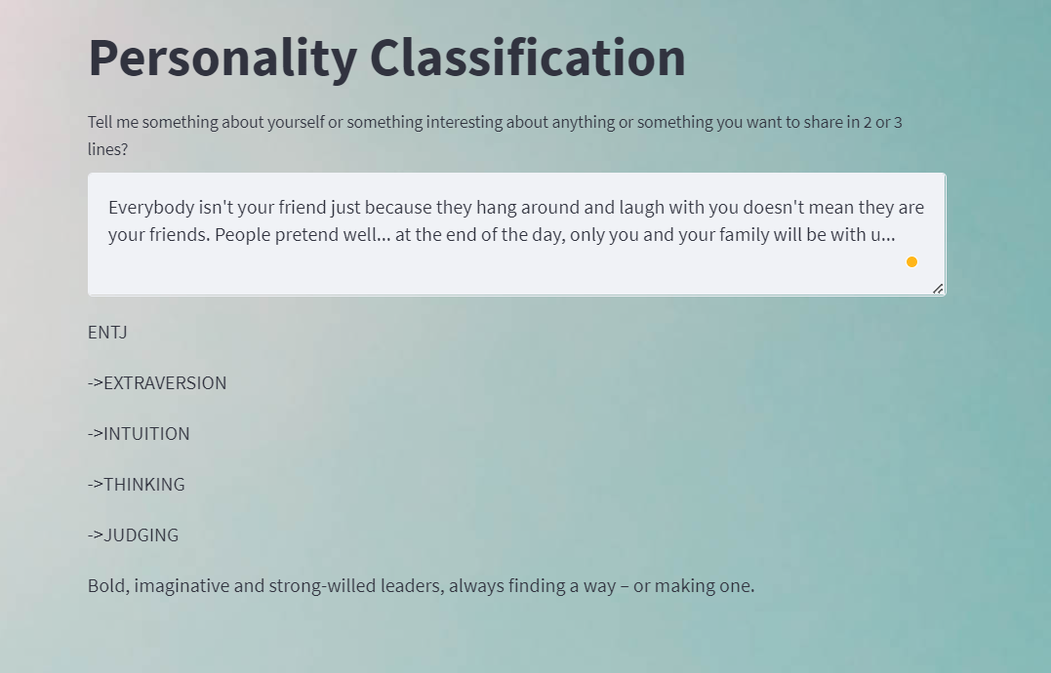
Design- Screen design
Dept of CSE., SOE-Dayananda Sagar University
<number> of 12

Slide 13
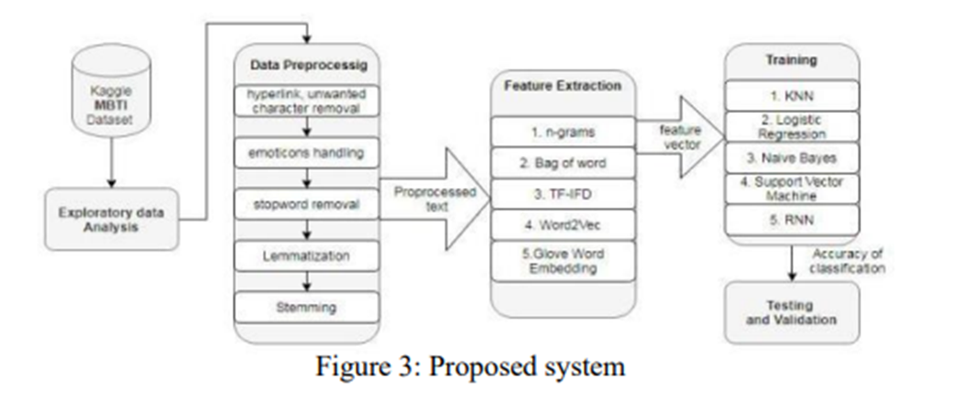
Methodology
First, we collected the MBTI dataset from Kaggle and real-time dataset and converted all the text/posts to lower case, removed the URL links, removed special characters and numbers from texts, removed the extra spaces, removed stop words, removed MBTI personality words from the text, then Lemmatization, and at last, reconstructed samples to be equal-sized chunks(Around 500 words per sample).
<number> of 12
Dept of CSE., SOE-Dayananda Sagar University

Slide 14
Methodology
We then found features using CountVectorizer by converting the posts into DTM matrix of word count, but we used TfidfVectorizer to weigh the importance of words (features) across all posts and select more relevant features
Then, we created a pipelined model in order to facilitate the entire process of Tfidf Vectorizer and different classification models. Later, we trained the model and saved it to the disk and started making predictions.
We then used the test data, which contains data from both MBTI dataset and collected data, to make predictions and analyze the accuracy of the different models.
At last, we take an input from the user, and we predict his personality.
<number> of 12
Dept of CSE., SOE-Dayananda Sagar University

Slide 15
EXPERIMENTATION
We have used Different Python Packages for our Project, those include
PANDAS: Pandas is an open-source library that is built on top of NumPy library. It is a Python package that offers various data structures and operations for manipulating numerical data and time series. It is mainly popular for importing and analyzing data much easier. Pandas is fast and it has high-performance & productivity for users.
PICKLE: The pickle module is used for implementing binary protocols for serializing and de-serializing a Python object structure.
PLOTLY: Python Plotly Library is an open-source library that can be used for data visualization and understanding data simply and easily. Plotly supports various types of plots like line charts, scatter plots, histograms, cox plots, etc.
<number> of 12
Dept of CSE., SOE-Dayananda Sagar University

Slide 16
EXPERIMENTATION
SKLEARN: the Sklearn library is mainly used for modelling data and it provides efficient tools
that are easy to use for any kind of predictive data analysis.
The main use cases of this library can be categorized into 6 categories which are the following:
Pre-processing
Regression
Classification
Clustering
Model selection
Dimensionality reduction
<number> of 12
Dept of CSE., SOE-Dayananda Sagar University

Slide 17
EXPERIMENTATION
Critical Code of the project
# Creating an instance to vectorizer:
vectorizer = TfidfVectorizer()
# Training the vectorizer:
X_train_tfidf = vectorizer.fit_transform(X_train)
# Training the classifier:
clf = LinearSVC()
clf.fit(X_train_tfidf, y_train)
# Pipelining the vectorizer and the classifier
text_clf = Pipeline([('tfidf',TfidfVectorizer()),('clf',LinearSVC())])
text_clf.fit(X_train, y_train)
# saving the model to disk
pickle.dump(text_clf, open(filename, 'wb'))
predictions = text_clf.predict(X_test)
<number> of 12
Dept of CSE., SOE-Dayananda Sagar University

Slide 18
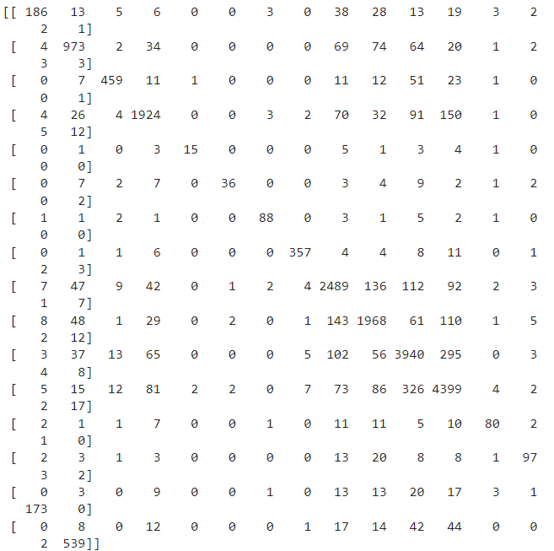
EXPERIMENTATION
print(confusion_matrix(y_test,predictions))
<number> of 12
Dept of CSE., SOE-Dayananda Sagar University

Slide 19
TESTING AND RESULTS
Screenshot of the Output
<number> of 12
Dept of CSE., SOE-Dayananda Sagar University

Slide 20
TESTING AND RESULTS
Serial No | Test Id | Input | Actual Output | Expected Output | Tested Output
1 | 121 | When the whole world is silent, even one voice becomes powerful. | ENJF | ENJF | Pass
2 | 122 | The important thing is not to stop questioning. Curiosity has its own reason for existence. | INTP | INTP | Pass
3 | 123 | When the whole world is silent, even one voice becomes powerful - Malala | INJP | INJP | Pass
<number> of 12
Dept of CSE., SOE-Dayananda Sagar University

Slide 21
TESTING AND RESULTS
Serial No | Test Id | Input | Actual Output | Expected Output | Tested Output
4 | 124 | They are attentive and people-focused, and they enjoy taking part in their social community. Encourage, lift, and strengthen one another. For the positive energy spread to one will be felt by us all. | INFJ | ESFJ | Fail
5 | 125 | Many of life’s failures are people who did not realize how close they were to success when they gave up - Thomas.A.Edison | INTJ | INTJ | Pass
<number> of 12
Dept of CSE., SOE-Dayananda Sagar University

Slide 22
TESTING AND RESULTS
Results Between the Comparison of Different Algorithms
Support Vector Classifier
 | Precision | Recall | F1_Score
ENFJ | 0.84 | 0.58 | 0.69
ENFP | 0.82 | 0.78 | 0.8
ENTJ | 0.9 | 0.8 | 0.84
ENTP | 0.86 | 0.83 | 0.84
ESFJ | 0.83 | 0.45 | 0.59
ESFP | 0.88 | 0.48 | 0.62
ESTJ | 0.9 | 0.84 | 0.87
ESTP | 0.95 | 0.9 | 0.92
INFJ | 0.81 | 0.84 | 0.83
INFP | 0.8 | 0.82 | 0.81
INTJ | 0.83 | 0.87 | 0.85
INTP | 0.84 | 0.87 | 0.86
ISFJ | 0.8 | 0.61 | 0.69
ISFP | 0.81 | 0.6 | 0.69
ISTJ | 0.86 | 0.68 | 0.76
ISTP | 0.89 | 0.79 | 0.84
 | 0.781044 | 0.850826 | 0.734408
Accuracy | 0.835439
Multinomial Naïve Bayes
 | Precision | Recall | F1_Score
ENFJ | 0.38 | 0.62 | 0.47
ENFP | 0.55 | 0.54 | 0.46
ENTJ | 1 | 0.29 | 0.02
ENTP | 0.6 | 0.66 | 0.61
ESFJ | 0.38 | 0.5 | 0.43
ESFP | 0.43 | 0.5 | 0.46
ESTJ | 0.76 | 0.61 | 0.46
ESTP | 0.76 | 0.61 | 0.46
INFJ | 0.38 | 0.5 | 0.43
INFP | 0.29 | 0.54 | 0.38
INTJ | 0.67 | 0.24 | 0.36
INTP | 0.26 | 0.38 | 0.41
ISFJ | 0.29 | 0.54 | 0.38
ISFP | 0.55 | 0.61 | 0.58
ISTJ | 0.63 | 0.45 | 0.59
ISTP | 0.58 | 0.61 | 0.69
 | 0.058116 | 0.305478 | 0.082994
Accuracy | 0.580751
Logistic Regression
 | Precision | Recall | F1_Score
ENFJ | 0.82 | 0.53 | 0.64
ENFP | 0.86 | 0.75 | 0.8
ENTJ | 0.9 | 0.74 | 0.81
ENTP | 0.84 | 0.8 | 0.82
ESFJ | 0.78 | 0.21 | 0.33
ESFP | 0.86 | 0.33 | 0.48
ESTJ | 0.96 | 0.7 | 0.81
ESTP | 0.95 | 0.85 | 0.9
INFJ | 0.8 | 0.84 | 0.82
INFP | 0.79 | 0.83 | 0.81
INTJ | 0.81 | 0.88 | 0.84
INTP | 0.83 | 0.88 | 0.86
ISFJ | 0.89 | 0.47 | 0.61
ISFP | 0.79 | 0.52 | 0.63
ISTJ | 0.85 | 0.51 | 0.64
ISTP | 0.9 | 0.71 | 0.79
 | 0.724331 | 0.850952 | 0.659541
Accuracy | 0.824833
<number> of 12
Dept of CSE., SOE-Dayananda Sagar University

Slide 23
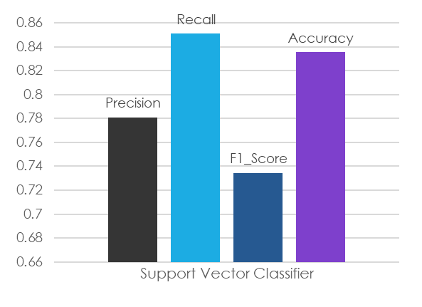
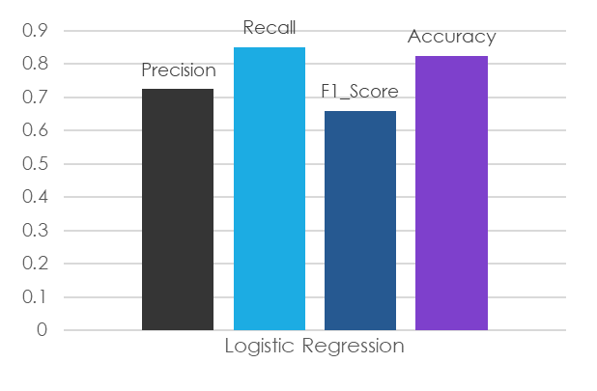
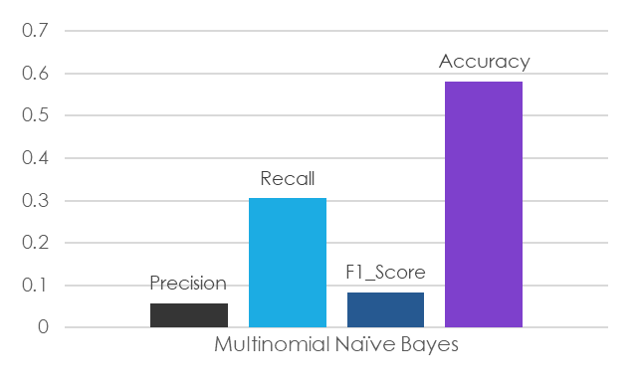
TESTING AND RESULTS
Results Between the Comparison of Different Algorithms
<number> of 12
Dept of CSE., SOE-Dayananda Sagar University

Slide 24
References
1. S Katiyar, H Walia, S Kumar – Personality Classification System using Data Mining 2020
2. Bayu Yudha Pratama, Riyanarto Sarno - Personality Classification Based on Twitter Text
3. Bhawna Singh, Swasti Singhal - Automated Personality Classification Using Data Mining Techniques
4. Sakdipat Ontoum, Jonathan H. Chan - Personality Type Based on MBTI with Text Posting Style by using ML and DL
5. Huansheng Ning, Sahraoui Dhelim, Nyothiri Aung – Friend Recommendation System Based on Big-Five Personality Traits and Hybrid Filtering
Dept of CSE., SOE-Dayananda Sagar University
Notes:
Title of the project
10/11/22
CSE Dept., SET-Jain University
Title of the project
10/11/22
CSE Dept., SET-Jain University

Slide 25
References
6. Automatic Personality Recognition of Authors Using Big Five Factor Model - Kasula Chaithanya Pramodh
7. Bottom-Up and Top-Down:Predicting Personality with Psycholinguistic and Language Model Features - Yash Mehta, Samin Fatehi
8. Personality Classification with Data Mining - Gaurav R. Savant (M.E. P.T. C.S.E.), Dr. G. R. Bamnote (Professor)
10/11/22
Dept of CSE., SOE-Dayananda Sagar University
<number> of 12
Notes:
Title of the project
10/11/22
CSE Dept., SET-Jain University

Slide 26
THANK YOU
Dept of CSE., SOE-Dayananda Sagar University
(#) of 12

